Slide 1

MACHINE LEARNING TECHNIQUES FOR OIL SPILL DETECTION
Manuel Gabrielli

Slide 2

Introduction
In this project I experiment two different techniques, Convolutional Neural Networks and Transfer Learning, for oil spill detection. I also consider techniques for data augmentation and artificial noise generation, to provide a wider spectrum of experiments.

Slide 3
Project Phases
Data Preparation
Preparation of the DataFrames containing the information on the classes to which the images belong.
Data Augmentation
Creation of generators of new images obtained by modifying the already existing ones, to obtain a larger set of images.
CNN Model
Creation of the model with Convolutional Neural Networks with respective training and evaluation phases on the test images.
Transfer Learning
Test with Noise
Introduction of noise on test images to test the robustness of the Transfer Learning model.
Use of the Transfer Learning technique by exploiting an already existing model, with respective training and evaluation phases on the test images.
Test with Noise
Introduction of noise on test images to test the robustness of the CNN model.

Slide 4
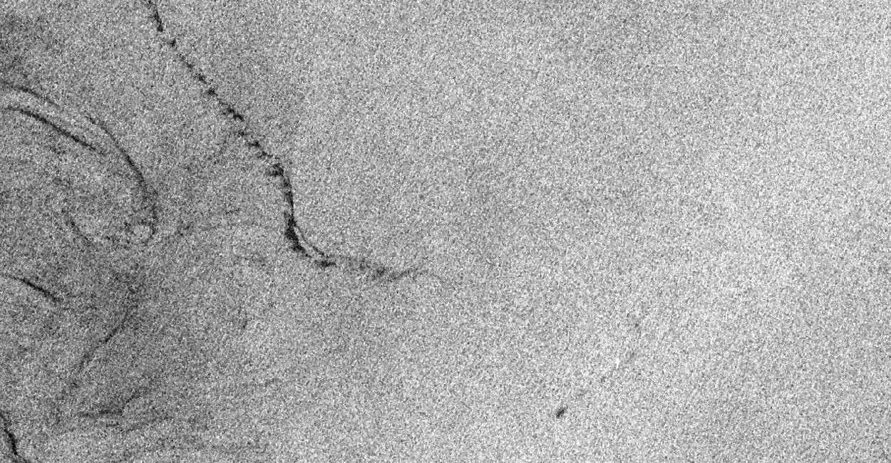
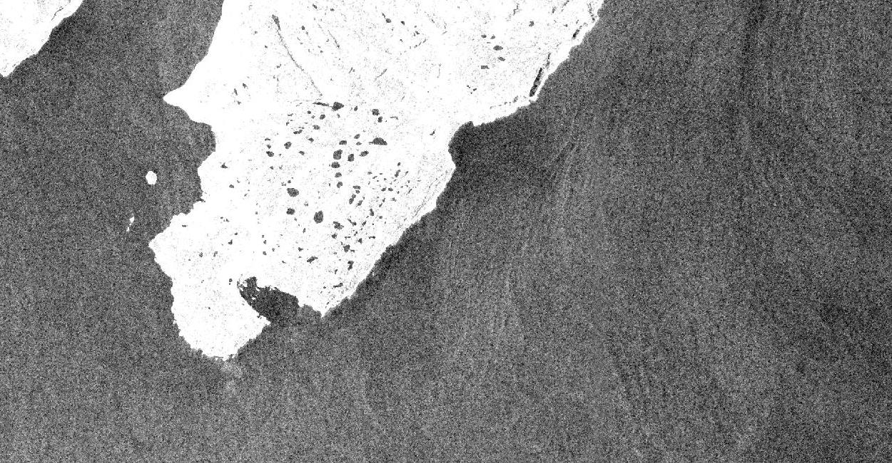
Dataset
The Dataset was developed by Social Media Analytics Laboratory.
It contains images extracted from satellite Synthetic Aperture Radar (SAR) data depicting oil spills and other relevant instances.
Images are split into training and test sets.
Each image can be associated with one or more classes based on what elements it represents.
Class values in the images are highly unbalanced
Example of Image with Oil Spill
Example of Image without Oil Spill

Slide 5
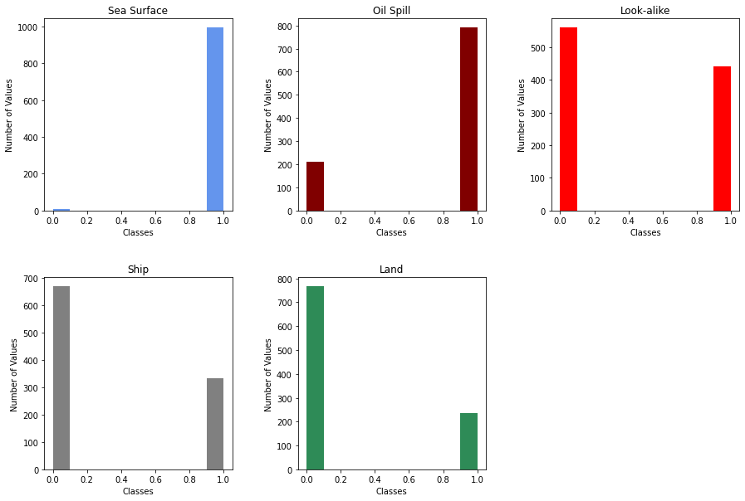
Class Distribution

Slide 6
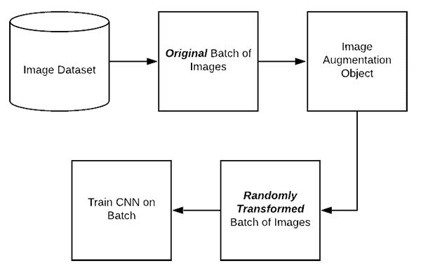
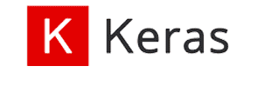
Data Augmentation
Image augmentation is a technique of applying different transformations to original images which results in multiple transformed copies of the same image.
ImageDataGenerator, provided by Keras, provides on-the-fly data augmentation.
Three Generators, the first is used to train the model, the second to evaluate the model during the training and the third to compare the predictions with the real values.

Slide 7
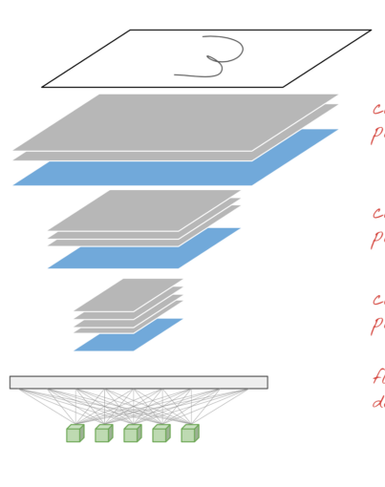
2D Convolutional Neural Network
This model employs a mathematical operation called Convolution, extremely fast in computation.
Sequential model of Keras.
Composed by 4 Convolutional layers, 2 deeply connected neural network layers and 1 final output layer.
Image

Slide 8
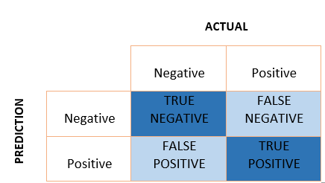

Evaluation Metrics
Accuracy alone does not provide the full picture of the model's predictive ability.
Three Evaluation Metrics:
Precision, calculated as $\frac{TP}{TP+TF}.$
Recall, calculated as $\frac{TP}{TP+FN}.$
F1-Score, calculated as $\frac{2∗Precision∗Recall}{Precision+Recall}$.

Slide 9
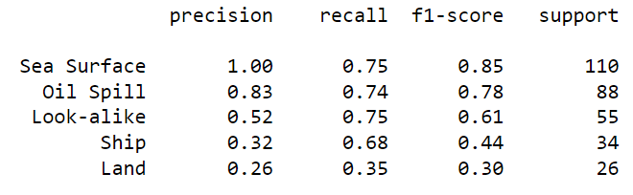
CNN Model Evaluation
The model is not particularly good at predicting all the classes to which each image belongs.
However, being the focus of the project on the 'Oil Spill’ class, the particularly low values for the other classes are not a big problem.

Slide 10
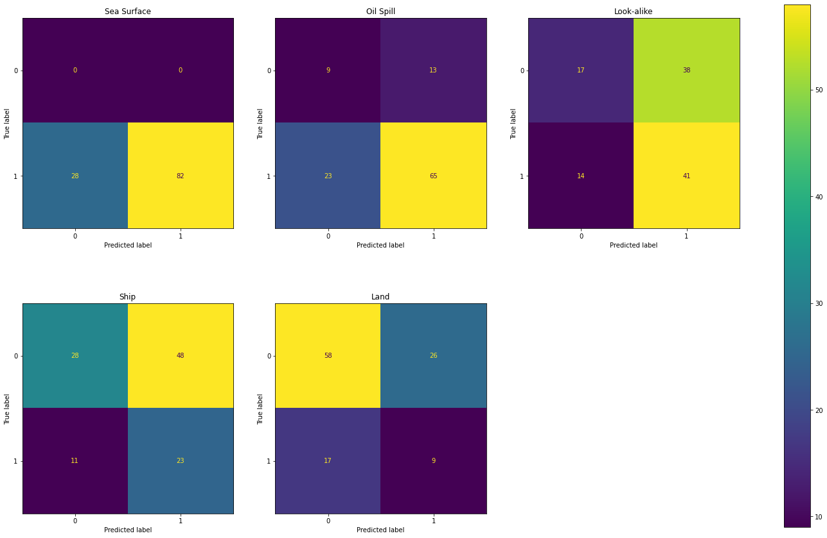
CNN Model’s Confusion Matrices

Slide 11
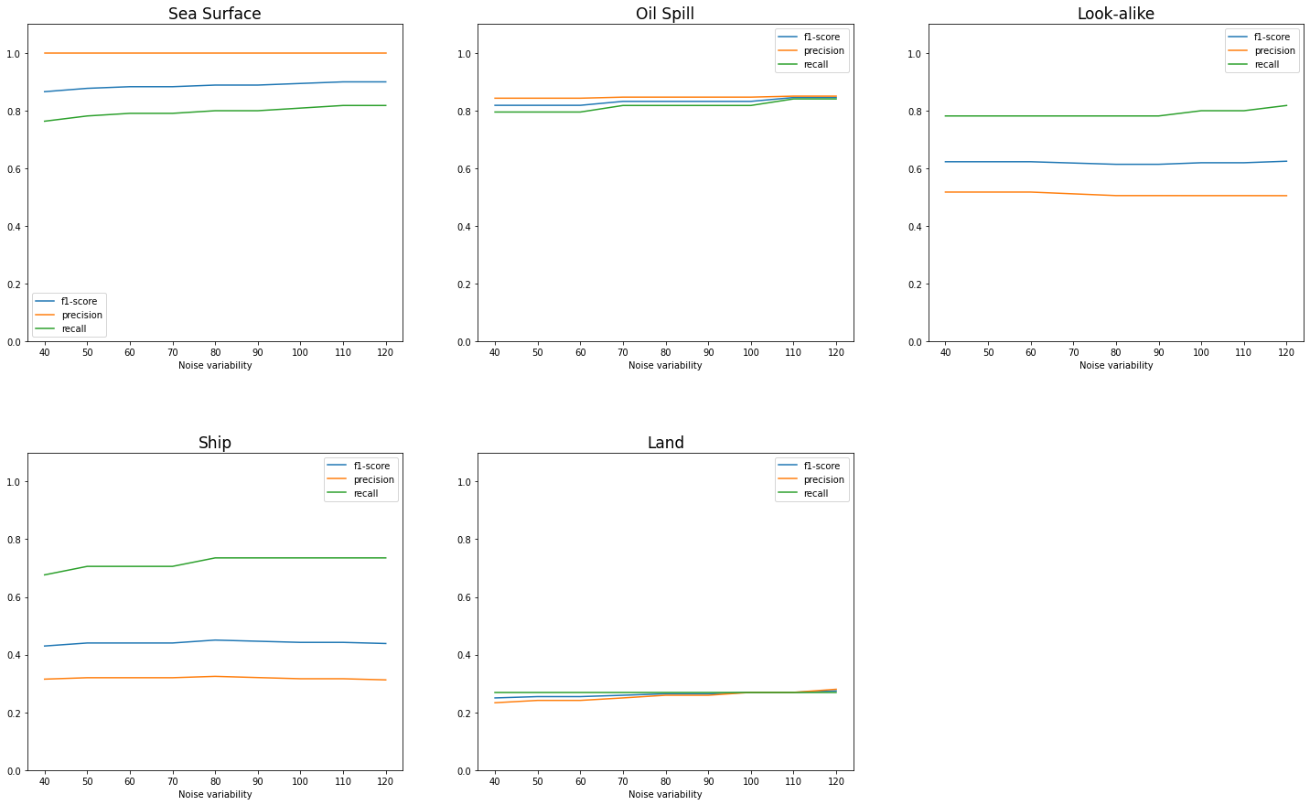
Test with Noise
The model was tested on test images affected by noise with incrementing variability.
The variability goes from 40 to 130, increasing by 10 each time.
The model is robust to noise since the values of the evaluation metrics do not decrease.

Slide 12
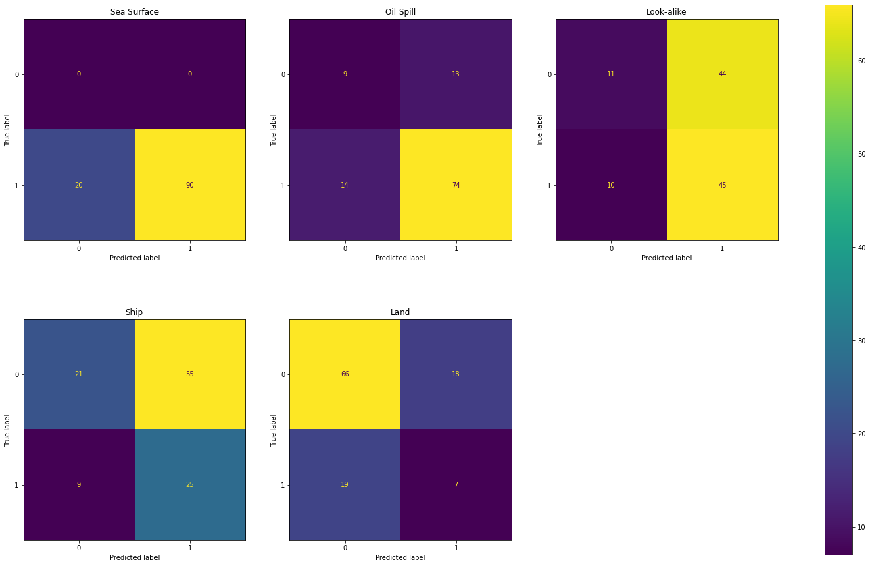
Test with Noise
Results are confirmed by the Confusion Matrices obtained on the results of the predictions on images with highest quantity of noise.

Slide 13
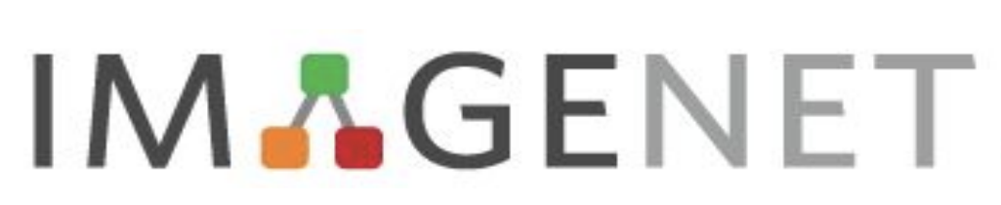
Transfer Learning Model
Machine Learning technique where a model developed for a task is reused as the starting point for a model on a second task.
Model trained on the ImageNet dataset, provided by TensorFlow hub.
The new model is obtained by incorporating the existing one and adding a new layer on top for training on the new images.

Slide 14
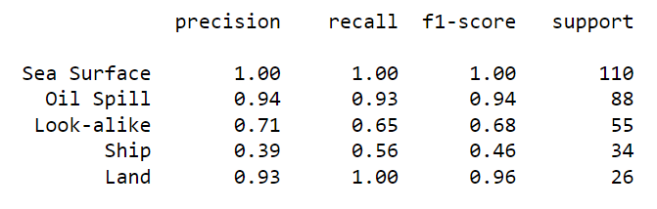
T.L. Model Evaluation
The evaluation metrics are the same.
In this model the values of the metrics are much higher than before.
The values of Precision, Recall and F1-Score for ‘Oil Spill’ class are very satisfying.

Slide 15
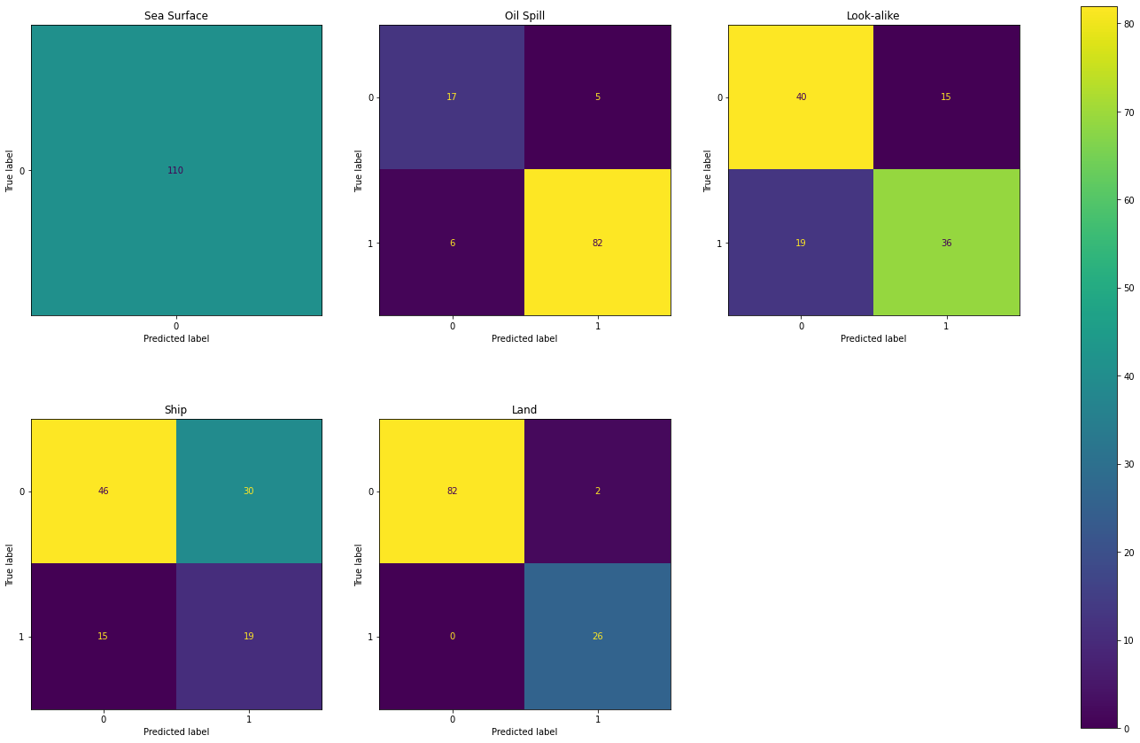
T.L. Model’s Confusion Matrices

Slide 16
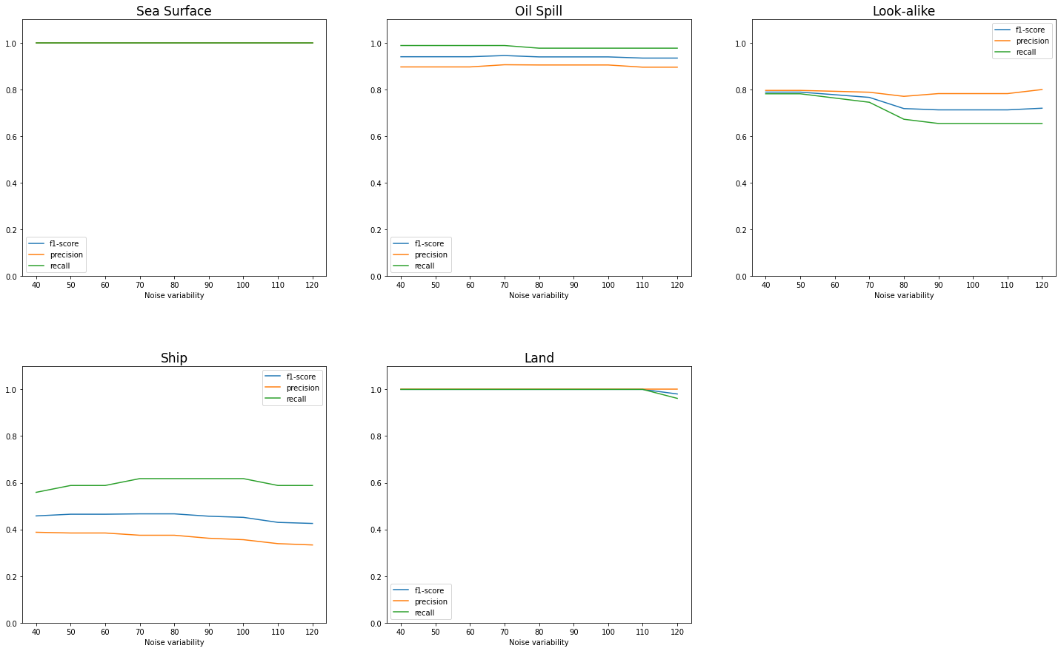
Test with Noise
Same way of testing the model on images affected by noise with incremental variability.
Accuracy and Recall values generally remain stable.
The model is robust to noise since the values of the evaluation metrics do not decrease much.

Slide 17
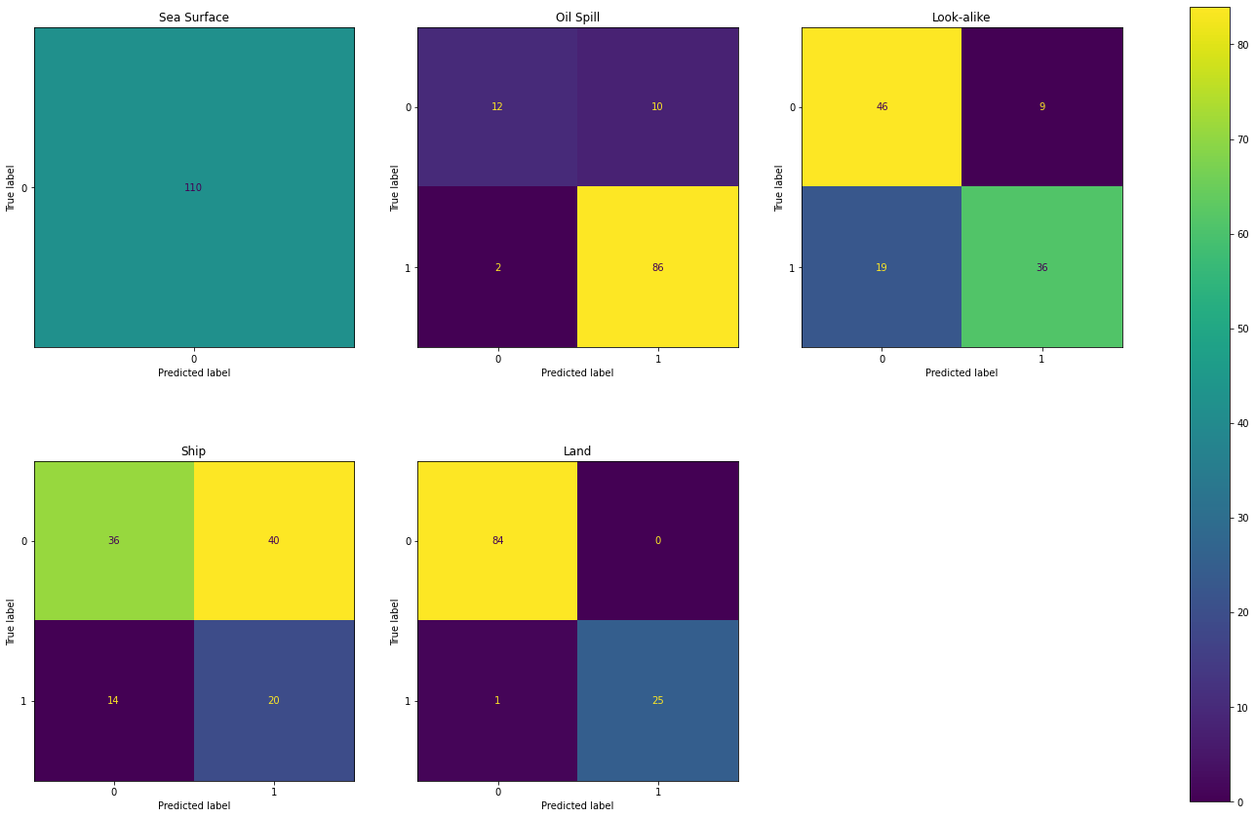
Test with Noise
Confusion Matrices, obtained on the results of the predictions on images with highest quantity of noise, confirm the robustness to noise of the model.

Slide 18
THANKS FOR YOUR ATTENTION
Manuel Gabrielli

